Slide 1
“Ranges In Progress”
System & Process Overview
Notes:
Merchandising Ranges in Progress System
Course
Notes
Version 2.0

Slide 2
New Ranging Systems Overview
Ranging
Controls
CW /RMS
(product
Info)
Ranging
System
(Assort)
ProSpace
ProSpace
VMCS
Ranges in
Progress
VMCS
(Store
Specific)
Supply Chain
Stores

Slide 3
Key Benefits
View and Select Range Data sent from CRST
Send Range Data to ProSpace
Extract Placeholders from CRST
Reconcile Ranges and Merchandise Plans
Authorise Ranges
Maintain Settings

Slide 4
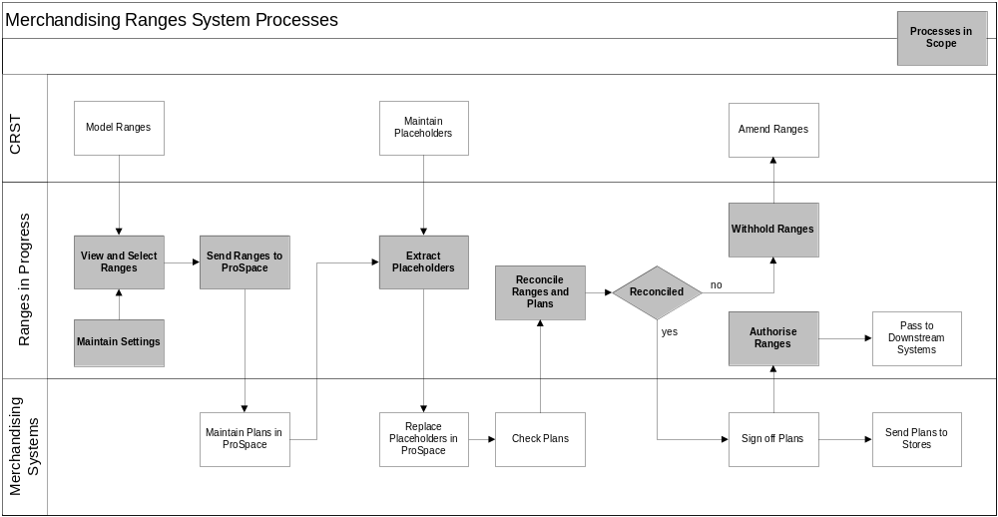
RIP System Process

Slide 5
Basic System Overview
LOGIN
MERCH GROUP
SUMMARY
(HOME)
RANGE
STATUS
STORE RANGE
GROUP INFO
RECONCILE
AUTHORISE
LEVEL OF
CHANGE

Slide 6
Navigation and Login
Basic Navigation
Login
Merchandising Group Summary Screen
LOGIN
MERCH GROUP
SUMMARY
(HOME)
RANGE
STATUS
STORE RANGE
GROUP INFO
RECONCILE
AUTHORISE
LEVEL OF
CHANGE

Slide 7
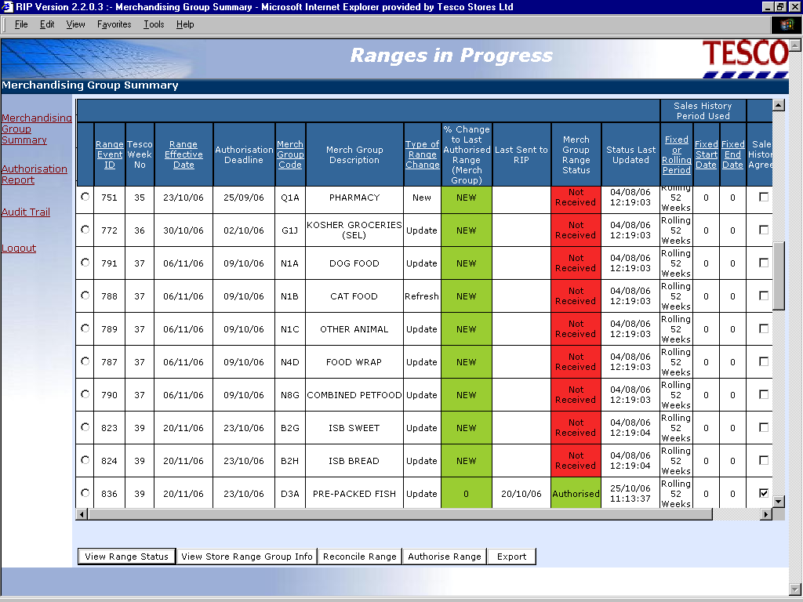

Slide 8
Range Status
Basic Navigation
View Range Status
View Range Status Details
LOGIN
MERCH GROUP
SUMMARY
(HOME)
STATUS
STORE RANGE
GROUP INFO
RECONCILE
AUTHORISE
LEVEL OF
CHANGE

Slide 9
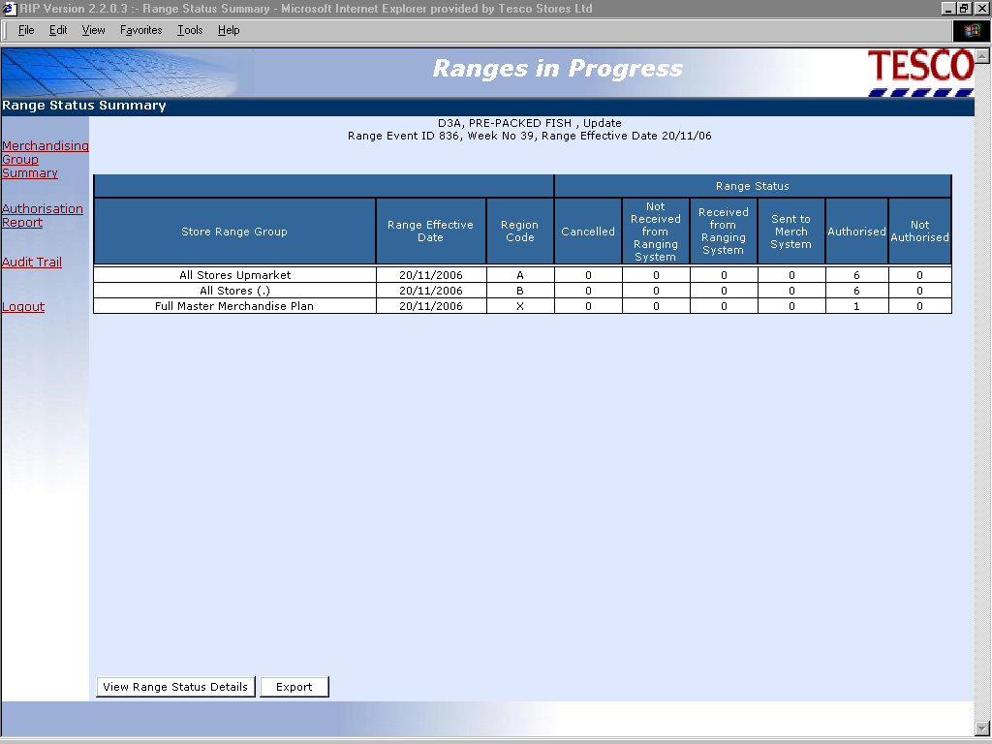

Slide 10
Store Range Group Info
Areas to cover
  Store Range Group Summary
  Level of Change
  Product Summary
  Product Detail
  Product Matrix
  Product Sales
LOGIN
MERCH GROUP
SUMMARY
(HOME)
STATUS
STORE RANGE
GROUP INFO
RECONCILE
AUTHORISE
LEVEL OF
CHANGE

Slide 11
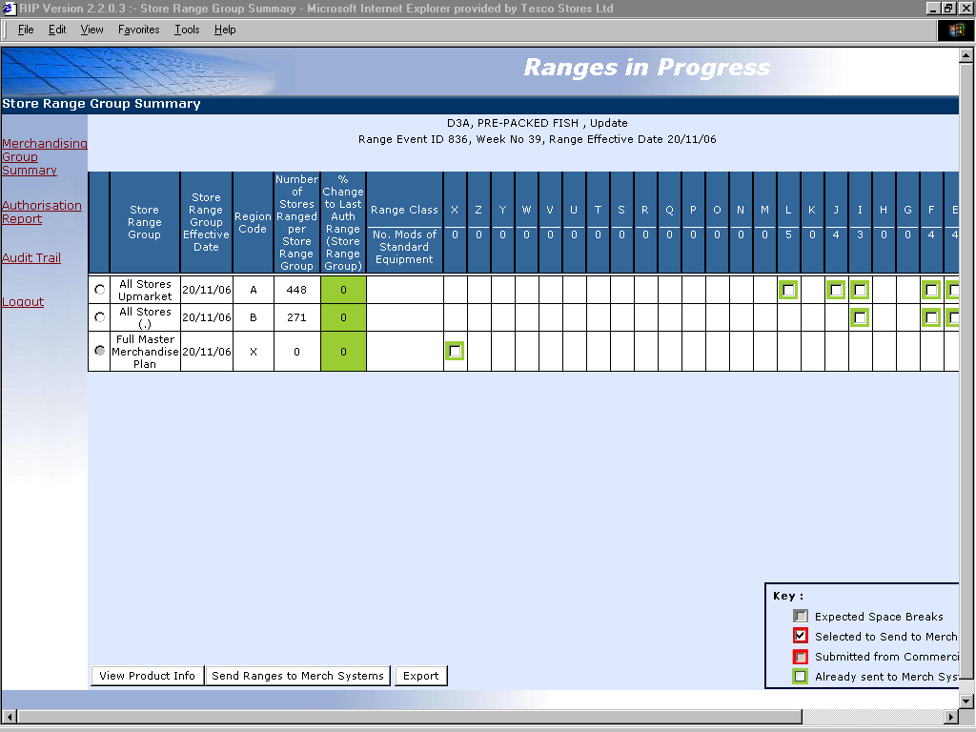

Slide 12
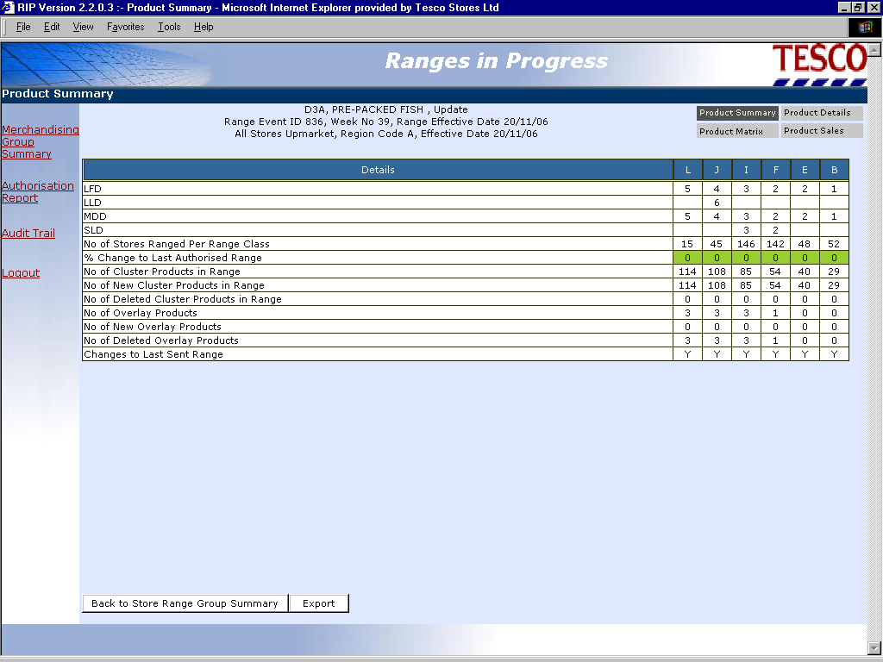

Slide 13
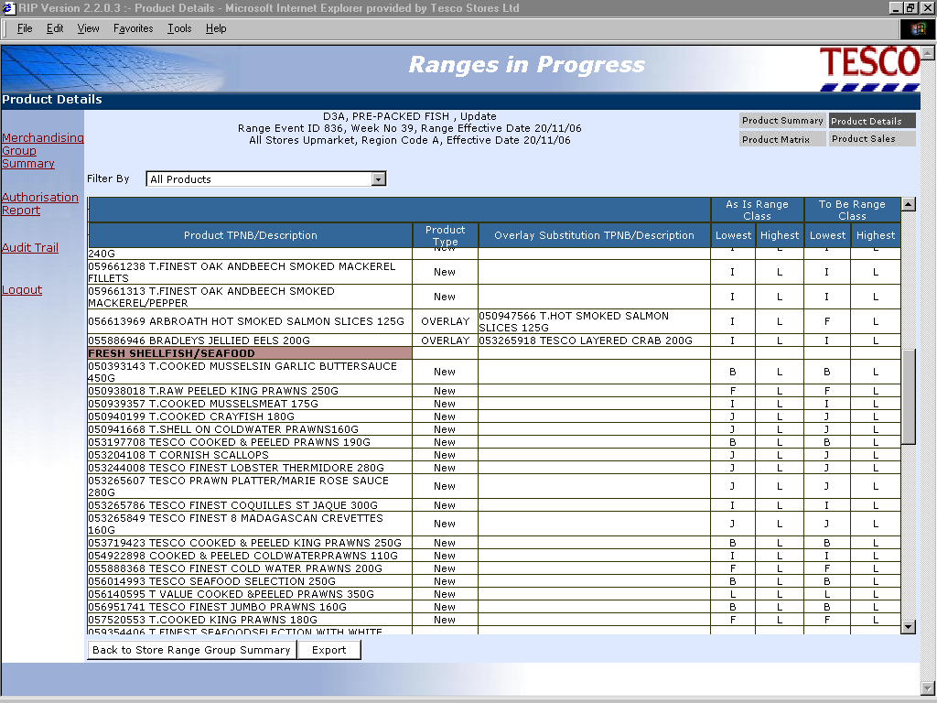

Slide 14
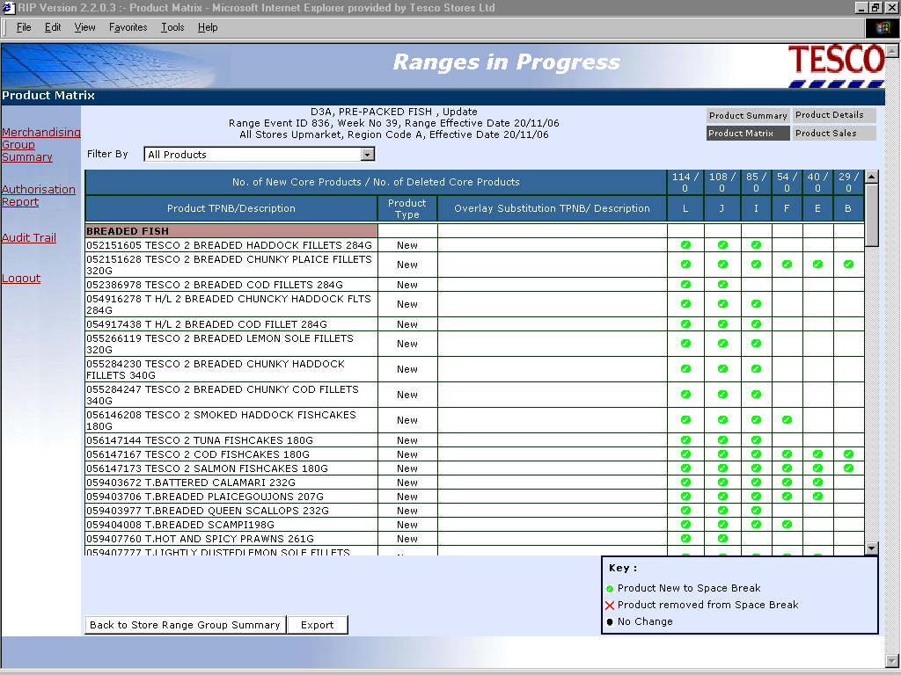

Slide 15
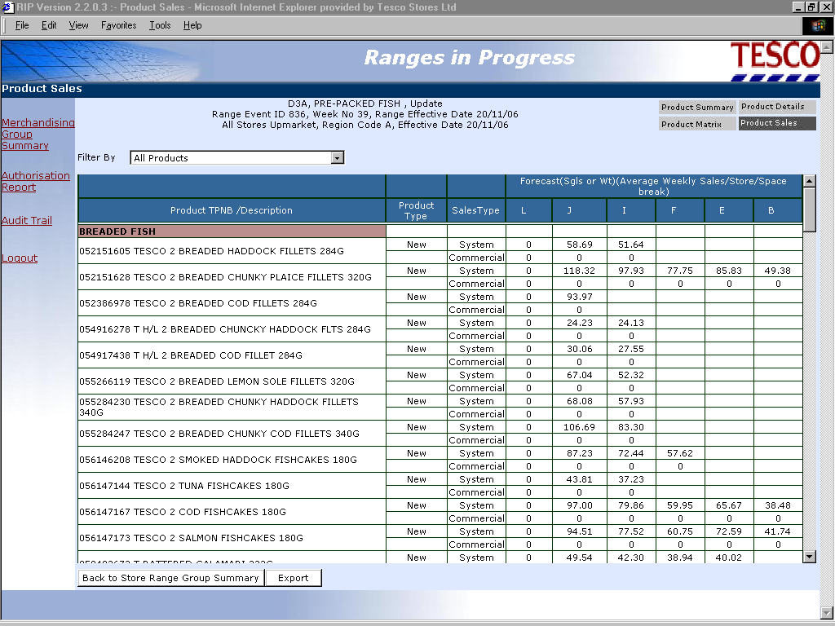

Slide 16
Product Sales
Sales used to build Merchandise Plans (in Work in Progress) are consistent with sales used to plan ranges in the Ranging system.
These can either be:
  “Rolling” i.e. 52 weeks average, the default for most Merchandising Groups
  “Fixed” i.e. defined sales history period, selected for highly seasonal areas
  “Forecast” i.e. system generated or input by Commercial for individual products, including new lines
Each time new range information is sent from Ranges in Progress to ProSpace the updated sales data is passed with it.
Actual sales are used to calculate Level Run Down on Plans (in Live) and are updated on a weekly basis.

Slide 17
Reconcile
Reconciliation Areas to cover
  Store Range Group
  Errors Summary
  Errors by Merchandising Group
  Errors by Level of Change
  Errors by Merchandising Plan
  Errors by Product
LOGIN
MERCH GROUP
SUMMARY
(HOME)
STATUS
STORE RANGE
GROUP INFO
RECONCILE
AUTHORISE
LEVEL OF
CHANGE

Slide 18
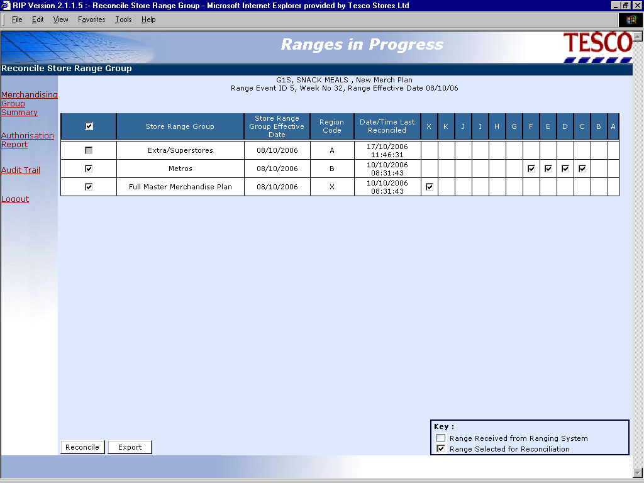

Slide 19
Reconciliation Errors
Products are in the range but not on the plan
Products are on the plan but not in the range
Dummy New Product present in ranges and plans
Products not currently authorised in CW
Products in a plan that don’t meet level run down in ProSpace
Products do not fit on a merchandise plan
Unacceptable levels of change within space breaks
Ranges expected but not received from the Ranging System
Inappropriate sales history used
No plans exist in ProSpace

Slide 20
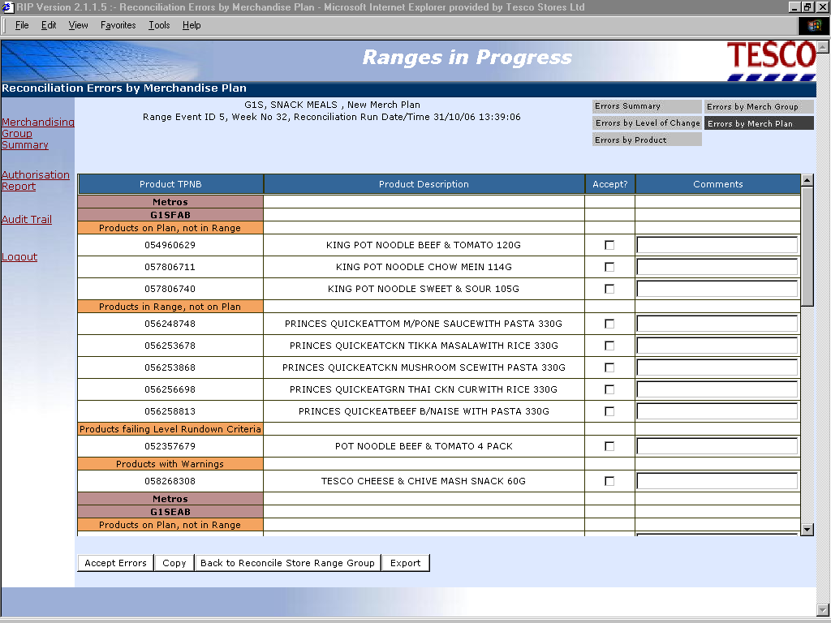

Slide 21
Authorise
Areas to cover
  Authorise Store Range Groups
  Final Reconciliation
  Authorise Ranges
LOGIN
MERCH GROUP
SUMMARY
(HOME)
STATUS
STORE RANGE
GROUP INFO
RECONCILE
AUTHORISE
LEVEL OF
CHANGE

Slide 22
Reconciliation Errors that can be Accepted
A reconciliation error screen will only be displayed if errors of the relevant type exist for the selected clusters during final reconciliation.
Only if all the errors for a cluster have been corrected or accepted will it be possible to authorise the cluster.
Notes:
Ranges in Progress - The System

Slide 23
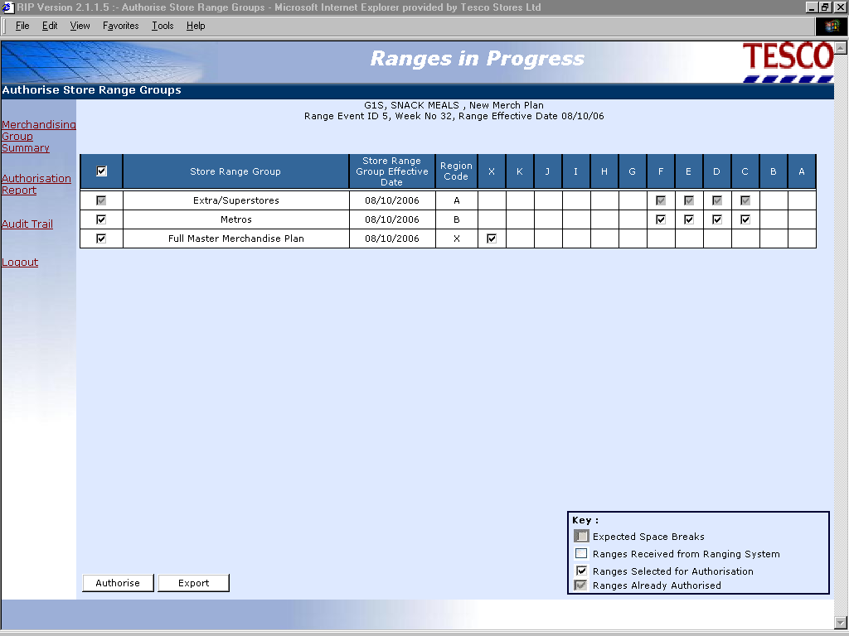

Slide 24
  Thank You !!

